Slide 1

Maternal Mortality Review Committee Member Orientation

Slide 2
Objectives
Review and define key terms
Provide an overview of the maternal mortality review history and data
Discuss the authorities and protections in place for maternal death review
Understand the Maternal Mortality Review Committee (MMRC) process
Review the MMRC roles and member responsibilities
Discuss the MMRC Timeline/First Meeting/Next Steps
sogc.org
Notes:
Instructions to program:
Review the objectives of the day with the committee members, update as needed to cover key topics in your specific orientation event.

Slide 3
Definitions
Maternal death – death of a woman during pregnancy or within 42 days of its termination, regardless of duration, for any cause related or aggravated by pregnancy
Maternal mortality ratio – maternal deaths per 100,000 live births
Pregnancy-associated death - A death during or within one year of pregnancy, regardless of the cause.
Pregnancy-related death - A death during pregnancy or within one year of the end of pregnancy from a pregnancy complication, a chain of events initiated by pregnancy, or the aggravation of an unrelated condition by the physiologic effects of pregnancy.
sogc.org

Slide 4
Background
A maternal death is devastating for families, and care providers.
International efforts have been made to develop and to implement data collection, management, and surveillance systems that capture pregnancy-related information that can be assessed and used to improve health and system outcomes, with the ultimate goal of preventing maternal deaths.
  USA (ERASE MM) www.cdc.gov/erasemm
  UK (MBRRACE) www.npeu.ox.ac.uk/mbrrace-uk
Maternal mortality is the tip of the maternal health iceberg, representing severely ill women with the most devastating outcome.
sogc.org

Slide 5
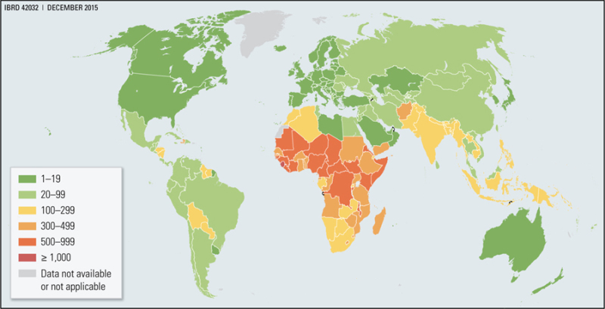
Maternal Mortality per 100,000 live births
sogc.org

Slide 6
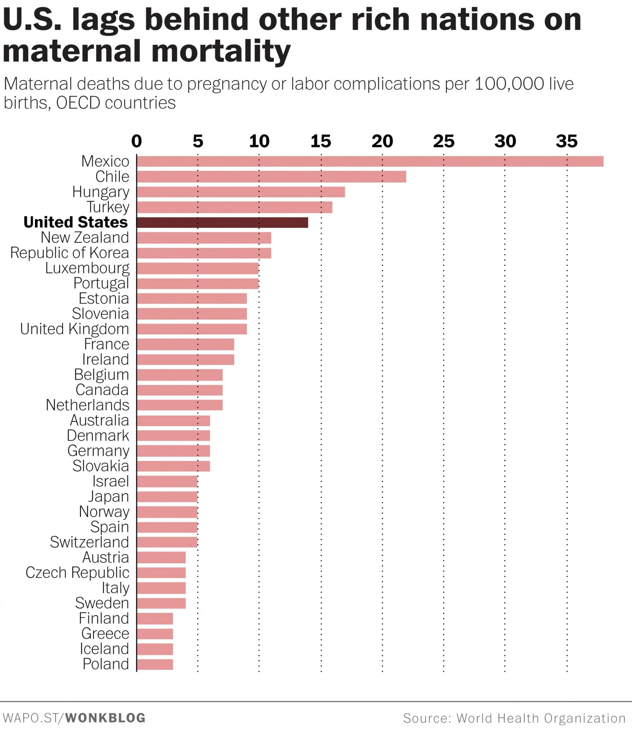
Maternal Mortality in
High income Countries
sogc.org

Slide 7
There is absolute consensus that the upper limit for a preventable maternal death is zero.

Slide 8
More Maternal Mortality Facts
US data show that > 60% of maternal deaths were preventable.
  Is the same is true for Canada….?????
There is a dose-response relationship between the probability that a woman will die during childbirth (or 42 days following the end of a pregnancy) and the number of risk factors and/or comorbidities that are present.
A number of studies have shown that substance use and mental health issues also contribute significantly to maternal deaths in Canada, in the USA and in the UK.
sogc.org

Slide 9
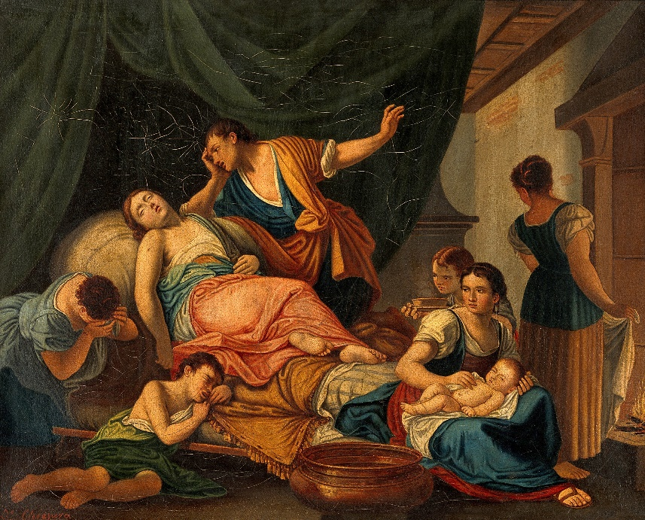

Maternal Mortality in Canada: A Preventable Tragedy?

Slide 10
The UK Mothers and Babies: Reducing Risk through Audits and Confidential Enquiries across the UK
Since 2014, the UK has been publishing lessons learned to inform maternity care from the UK and Ireland confidential enquiries into maternal deaths and morbidity.
They have a rigorous and effective system that presents an accurate and timely picture of maternal mortality
According to their latest report, improvements in care which may have made a difference to the outcome were identified more than half of the women who died.
  The majority of recommendations are drawn directly from existing guidance or reports and denote areas where implementation of existing guidance needs strengthening.
  In a small number of instances, actions are needed for which national guidelines are not available
sogc.org

Slide 11
Maternal Mortality in Canada……????
Canada does not have a national enquiry process to review maternal deaths, severe morbidity, and near misses, and has NOT set targets for maternal mortality reduction.
Canada’s existing data do not tell the true story of maternal deaths; we cannot learn from each death and its circumstance to identify measures for prevention in the future.
sogc.org

Slide 12
Let the Data do the Talking
Canadian data sources for maternal mortality are based on provincial death registrations and hospitalization data
  Neither provide clinical and social contexts required to identify prevention strategies.
The Canadian Institute for Health Information data provides no cause of death
Some provinces/territories are not included in all datasets
Different datasets report different numbers
Existing data sources consistently under-ascertain and misclassify maternal deaths, leading to an underestimation of Canada’s MMR
  Pregnancy/maternal not always identified
  The WHO uses an adjustment coefficient for Canada of 60% upwards to correct for underreporting of maternal deaths
Canada is behind other developed countries
sogc.org

Slide 13
MMR in Canada: Statistics Canada vs WHO Adjusted Rates
Notes:
Statistics Canada reported rates, WHO Adjusted rates (*1.6)

Slide 14
Maternal Deaths in Canada 2017-2018 (Statistics Canada)
 | Number of deaths |  | Mortality Rate /100,000
 | 2017 | 2018 | 2017 | 2018
All obstetric causes | 25 | 32 | 6.64 | 8.59
>42 days of delivery | 3 | 1 | 0.80 | 0.27
Within 42 days | 22 | 31 | 5.85 | 8.33
Within 1 year | 23 | 32 | 6.11 | 8.59
* Yukon data not included; 2018 reported before year end so is a shortened year
Notes:
The most common diagnoses associated with maternal deaths in 2018 included the following two direct obstetric causes: complications predominantly related to the early (6 weeks) postpartum period (puerperium) (10 deaths), and postpartum hemorrhage (5 deaths). In addition, several maternal deaths were attributed to indirect causes (6 deaths), which include deaths resulting from previous existing disease or disease that developed during pregnancy, but not caused by the pregnancy itself.
To improve the timeliness of the data, the collection period was shortened in 2018 compared with previous years. As a result, 2018 data are considered preliminary. The data will be revised in future releases from StatsCan.
Data on the causes and number of deaths for deaths that occurred in Yukon or to residents of Yukon in other provinces and territories are not available.

Slide 15
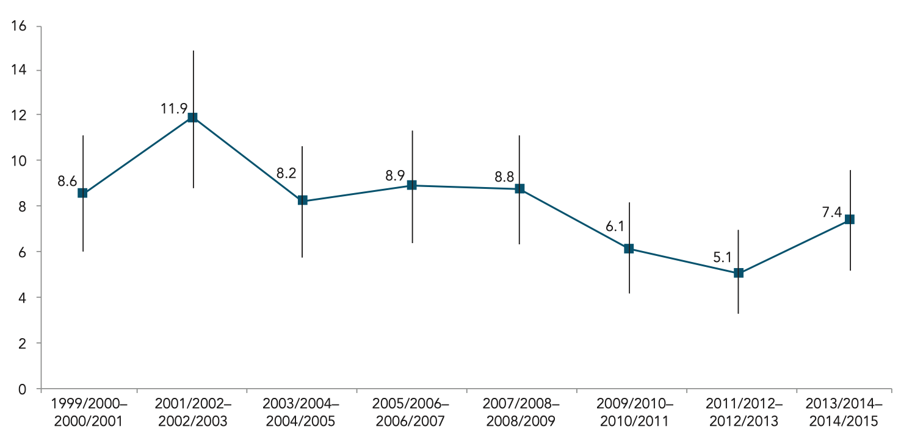
Pregnancy-Related Mortality Rate in Canada (Excluding Quebec)
Source: Canadian Institute for Health Information-Discharge Abstract Database (CIHI-DAD). Manitoba data, which were incomplete for earlier years, were included from 2004/2005. Data for Quebec were excluded because they do not contribute to CIHI-DAD.
sogc.org
sogc.org
Notes:
The definition of pregnancy-related mortality under the International Statistical Classification of Diseases, Tenth Revision (ICD-10) is: “the death of a woman while pregnant or within 42 days of termination of pregnancy, irrespective of the cause of death (obstetric and non-obstetric).” In this report, the pregnancy-related mortality rate is expressed as the number of these deaths in hospital per 100,000 pregnancies (hospital births, ectopic pregnancies, miscarriages and terminations). This measure differs from the commonly reported maternal mortality ratio, which is defined per 100,000 live births, as “the death of a woman while pregnant or within 42 days of termination of pregnancy, irrespective of the site of the pregnancy, from any cause related to or aggravated by the pregnancy or its management but not from accidental or incidental causes”.
Data from the Canadian Institute of Health Information (CIHI)’s Discharge Abstract Database (DAD) were used to identify in-hospital deaths among women of reproductive age (15–54 years) in Canada. Data from Quebec were excluded because they do not contribute to the DAD. CIHI data were used instead of the more traditional vital statistics data because studies by the Canadian Perinatal Surveillance System have shown that hospitalization data are more comprehensive and timely
Deaths that occurred outside the hospital were not included in this analysis. The DAD data include multiple diagnostic codes for each death, but do not assign an underlying cause of death. Therefore, the more commonly reported maternal mortality ratio which takes into consideration the underlying cause of death cannot be presented from these data.

Slide 16
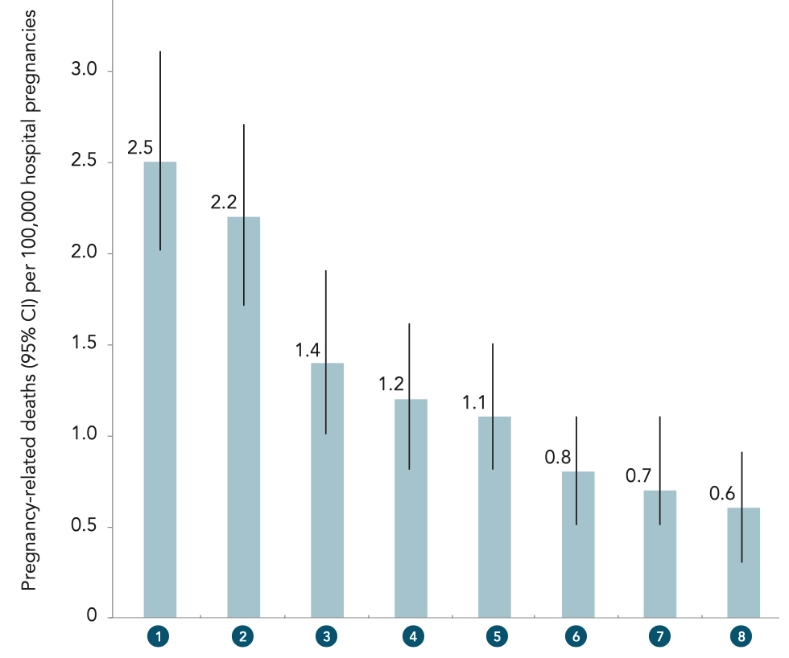
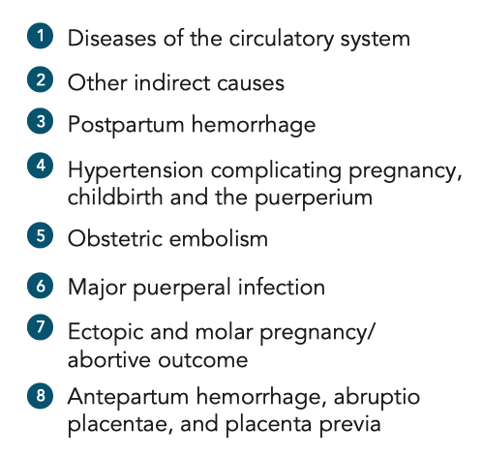
Cause of Pregnancy-Related Deaths in Canada (Excluding Quebec)
Source: Canadian Institute for Health Information-Discharge Abstract Database (CIHI-DAD)
Manitoba data, which were incomplete for earlier years, were included from 2004/2005.
Data for Quebec were excluded because they do not contribute to CIHI-DAD.
CI = confidence interval
sogc.org
Notes:
The most common diagnostic categories associated with these deaths in 2002/2003 to 2014/2015 were diseases of the circulatory system; other indirect causes (e.g., diseases of the digestive system, mental disorders and diseases of the nervous system complicating pregnancy, childbirth and the puerperium); postpartum hemorrhage; hypertension complicating pregnancy, childbirth and the puerperium; and obstetric embolism (Figure 5.2). The rates are of diagnoses associated with each death rather than of the underlying cause as the DAD does not report the underlying cause of death. Multiple diagnoses could be coded for each death

Slide 17
Factors Associated with Maternal Deaths in Canada
Medical comorbidities
Mental health
Substance use
Marginalized populations
Human resource shortages
Care provider fatigue and burn out
Experience and competence in operative and critical care obstetrics
sogc.org

Slide 18
So What Are We Doing?
2004 – Special Report on Maternal Mortality and Severe Morbidity in Canada
In 2010, the WHO urged the SOGC to work with partners to review national maternal mortality surveillance.
The SOGC brought together national and international experts to examine the issue of maternal mortality in Canada.
  Little standardization across jurisdictions for definitions, data collection, maternal mortality review processes.
  Not all provinces/territories review maternal deaths.
The group called for the establishment of
A centralized confidential enquiry system dedicated to identifying the underlying causes of all maternal deaths, including identification of those that are preventable.
sogc.org

Slide 19
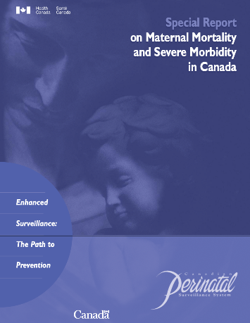
Maternal Mortality Review in Canada
Goal: To end preventable maternal mortality, reduce pregnancy-related deaths and decrease severe maternal morbidity.
Use standard definitions
Use standard processes
Use standard tools
Examine surveillance data
Broad case identification
Abstract case data from all sources
Summarize case data for review
Summarize findings and recommendations
  Translate information/recommendations for action (directly/indirectly)
    Specify dissemination and follow-up
sogc.org

Slide 20
Maternal Mortality Review Cycle
sogc.org
Notes:
Part of an ongoing quality improvement cycle
Incorporates multidisciplinary expertise, typically staffed by/hosted by public health agency
Leads to understanding of the drivers of a maternal death and determination of what interventions will have the most impact at patient, provider, facility, system and community level to prevent future deaths

Slide 21
Impact
Deaths
Near Misses
Severe Maternal Morbidity
Maternal Morbidity Requiring Hospitalization
Maternal Morbidity Resulting in Emergency Department Visit
Maternal Morbidity Resulting in Primary Care Visit
Sourced from: Building U.S. Capacity to Review and Prevent Maternal Deaths. (2018). Report from nine maternal mortality review committees.
http://reviewtoaction.org/Report_from_Nine_MMRCs
sogc.org
Notes:
Instructions to program:
Discuss how maternal deaths relate to broader goals to prevent maternal morbidity.
Possible script for slide:
Maternal deaths are only the most extreme of bad outcomes. They are the tip of the iceberg.
There are approximately XXX severe maternal morbidities that occur each year in Canada and far greater numbers of women who experience less severe complications of pregnancy…..
CLICK (next slide continues the pyramid)

Slide 22
Impact
Cascading Effects of Review Committee Actions
Eliminate preventable maternal deaths
Improve population health of women
Reduce maternal morbidity
Deaths
Near Misses
Severe Maternal Morbidity
Maternal Morbidity Requiring Hospitalization
Maternal Morbidity Resulting in Emergency Department Visit
Maternal Morbidity Resulting in Primary Care Visit
Sourced from: Building U.S. Capacity to Review and Prevent Maternal Deaths. (2018). Report from nine maternal mortality review committees. http://reviewtoaction.org/Report_from_Nine_MMRCs
sogc.org
Notes:
Instructions to program:
Discuss how maternal deaths relate to broader goals to prevent maternal morbidity.
Possible script for slide:
We believe that by comprehensively reviewing every death, making recommendations for action, and acting on those recommendations, the work of maternal mortality review committees can:
eliminate preventable maternal deaths, but also….
reduce maternal morbidities, and improve population health of women of reproductive age.

Slide 23
Maternal Mortality Review…
IS
    Ongoing anonymous and confidential process of data collection, analysis, interpretation and action
    Systematic process guided by policies, legislation, rules, etc.
    Intended to move from data collection to prevention activities
IS NOT
    A mechanism for assigning blame or responsibility for any death
    A research study
    Peer review
    An institutional review
    A substitute for existing mortality and morbidity inquiries
Sourced from: Berg, C., Danel, I., Atrash H., Zane, S. Bartlett, L. (Eds.). Strategies to reduce pregnancy-related deaths: From identification and review to action. Atlanta: Centers for Disease Control and Prevention; 2001
sogc.org
Notes:
Instructions to program:
Emphasize what a maternal mortality review is and is not

Slide 24
Overview of the Maternal Mortality Review Committee Process

Slide 25
What is a Maternal Mortality Review Committee?
A Maternal Mortality Review Committee (MMRC) is a multidisciplinary committee focused on reviewing causes of maternal death.
The purpose of the review is to determine the causes of maternal mortality and identify both medical and non- medical interventions and recommendations to prevent future maternal deaths.
The goals of committee review and associated work are to:
  Determine the annual number of maternal deaths related to pregnancy
  Identify trends and risk factors
  Develop actionable strategies to eliminate preventable maternal deaths
sogc.org

Slide 26
MMRC Scope, Mission and Vision
Scope To review all deaths of women during pregnancy or up to 42 days afterwards (ideally 365 days), regardless of cause. | Mission To identify the factors contributing to maternal deaths and recommend public health and clinical interventions that may reduce these deaths and improve systems of care. | Vision The Maternal Mortality review Committee’s vision is to eliminate preventable maternal deaths, reduce maternal morbidities, and improve population health for women of reproductive age.
sogc.org

Slide 27
MMRC Logic Model
Process
Outcomes
INPUTS
ACTIVITIES
OUTPUTS
SHORT-TERM
INTERMEDIATE-TERM
LONG-TERM
Legislative authority and protections
Authority to access required data
Confidentiality
Immunity for committee members from subpoena
Leadership buy-in
Staff
Funding
Defined scope and explicit protocols
Data
Vital records
Medical records
Social service records
Defined stakeholders and membership
With status or authority to implement recommendations within their organizations
Broad representation
Secure any missing inputs (from previous column)
Periodically recruit and train committee members
Identify cases and select cases for abstraction
Abstract cases and produce case summary
Convene committee meeting, review cases, and make key committee decisions
Disseminate recommendations
Identify implementation resources
Fully functional and sustainable MMRC
Robust, accurate data
Health surveillance and data analysis build evidence base
Recommendations
Reports and presentations
Campaigns, training, and initiatives
Awareness of the existence and recommendations of the MMRC among the public, clinicians, and policy-makers
Adoption of policy changes by health systems
Implementation of data-driven recommendations e.g., evidence-based practices, screenings, and patient education by providers, etc.
Widespread adoption of quality care initiatives and/or policies that reflect the highest standard of care
Access to holistic care during pregnancy and postpartum period (e.g., prenatal, diabetes, mental health, and substance use disorder care, etc.)
Coordination of care across providers
Elimination of disparities in pregnancy-related deaths
Elimination of preventable maternal death
Reduction in maternal morbidity
Improvement in population health for women of reproductive age including reductions in hypertension, obesity, smoking, substance use, and other chronic diseases
MMRC recommendations are part of a cycle of continuous quality improvement for health systems and quality care.
Assumptions: Province/territory has a coordinated group, perinatal program, or other infrastructure to implement MMRC recommendations, a functioning system for quality autopsy and political will and support.
sogc.org
https://reviewtoaction.org/national-resource/mmrc-logic-model

Slide 28
Authorities and Protections
Enter provincial/territorial data
sogc.org

Slide 29
Committee Membership
Core Disciplines | Specialty Disciplines
Anesthesiology | Cardiology
Family Medicine | Clergy
Pathology | Community Leadership
Maternal Fetal Medicine | Critical Care Medicine
Midwifery | Nutrition
Obstetrics and Gynecology | Emergency Response
Patient Safety | Epidemiology
Nursing | Genetics
Psychiatry | Home Nursing
Public Health Internal Medicine Neonatology Emergency medicine | Law Enforcement
Social Work | Mental Health Provider
 | Pharmacy
 | Public Health Nursing
 | Quality/Risk Management
 | Addiction Counseling
Review to Action
Identify
Action
Cycle
Review
Select
Abstract
Sourced from: Review to Action (https://reviewtoaction.org/)
sogc.org
Notes:
Instructions to program:
Discuss approach to committee membership – how does your state committee ensure multidisciplinary representation? What organizations, core disciplines, and specialty disciplines are currently on your state/jurisdiction’s committee?
Possible script for slide:
The perspectives captured via a multidisciplinary MMRC provide a greater understanding of opportunities to prevent deaths at the local, state and national levels. It is important to build strong group dynamics that emphasize trust and respect of diverse viewpoints.

Slide 30
Identification of Deaths
The first task for maternal mortality review committees is to comprehensively identify pregnancy-associated deaths.
Typically, pregnancy-associated deaths are identified by a hospital or care provider, or Vital Statistics Records.
Vital records (birth and death certificates) are the primary sources for identifying pregnancy-associated deaths.
Review to Action
Identify
Action
Cycle
Review
Select
Abstract
Sourced from: Review to Action (https://reviewtoaction.org/)
sogc.org
Notes:
Possible script for slide:
Case identification is the first task of any MMRC. Typically, preg.-associated deaths are identified by a hospital or care-provider, or Vital Statistics Records or similar entity and vital records (i.e. birth and death certificates) are the primary source for identifying pregnancy-associated deaths.

Slide 31
Selection of Deaths for Review
Jurisdictions determine their scope based on available resources.
Some jurisdictions may limit to cases most likely to be causally related to pregnancy (i.e. may exclude motor vehicle deaths from reviews).
Review to Action
Identify
Action
Cycle
Review
Select
Abstract
Sourced from: Review to Action (https://reviewtoaction.org/)
sogc.org
Notes:
Instructions to program:
Review case selection approach specific to your jurisdiction.
Possible script for slide:
Case selection is the next phase of the action cycle. Jurisdictions determine their scope for review based on available resources – and some jurisdictions may have to limit cases most likely to be causally related to pregnancy (i.e. they may exclude motor vehicle deaths from review).

Slide 32
Abstraction
  Recommended sources for information for abstraction:
  Vital statistics (death certificates, birth certificates, fetal death records)
  Prenatal records
  Hospital records (outpatient and inpatient stays)
  Outpatient clinic records: these records may be from preconception/family planning clinics or primary care centers
  Autopsy reports and case findings from hospitals, coroners, or other medical examiners
  Police/investigative reports
  Medical transport records
  Personal interviews of providers, family, or friends
Review to Action
Identify
Action
Cycle
Review
Select
Abstract
Sourced from: Review to Action (https://reviewtoaction.org/)
sogc.org
Notes:
Instructions to program:
Discuss the variety of case abstraction sources – include other sources available to abstractors in your jurisdiction as appropriate.
Possible script for slide:
Case abstraction is the next phase and involves collecting sources from a large variety of places – including various vital and medical record sources, as well as other social services.

Slide 33
Identification
Best Practices Identified Across MMRCs
Vital Record Linkage (maternal death and birth or fetal death)
  Death certificates linked with birth and fetal death certificates for year prior to death
  Death records should be selected for linkage if they are for:
    Women ages 10 – 60 years and residents of the province/territory, regardless of where the death occurred
  Death certificates that did not link, but have pregnancy checkbox marked, or contain ICD-10 O codes or select key words (e.g., amniotic, eclampsia)
Additional sources:
  Linkage of deaths to hospital discharge records (pregnancy codes)
  Hospital reporting
  Social media
  Obituaries
Sourced from: Reference Guide for Pregnancy-Associated Death Identification
https://reviewtoaction.org/content/pregnancy-associated-deaths-brief-case-review
sogc.org
Notes:
Instructions to program:
Review the best practices for case identification

Slide 34
Guiding Questions for Review Committees
Was the death pregnancy-related?
What was the underlying cause of death?
Was the death preventable?
What are the contributing factors to the death?
What specific and feasible actions might have changed the course of events?
Review to Action
Identify
Action
Cycle
Review
Select
Abstract
Sourced from: Review to Action (https://reviewtoaction.org/)
sogc.org
Notes:
Instructions to program:
Review guiding/facilitation questions for committees consideration as they review cases.
Possible script for slide:
Committees review each death to determine whether it was causally related to pregnancy, to determine the underlying cause of death, and whether or not that is in agreement with what was listed on the death certificate.
Then the committee assesses preventability. A death is considered preventable if the committee determines that there was at least some chance of the death being averted by one or more reasonable changes to patient, family, community, provider, facility, and/or systems factors.
If the death is considered preventable, the committee then discusses the contributing factors and what specific and feasible actions might have changed the course of events. Those actions form the basis for their recommendations.

Slide 35
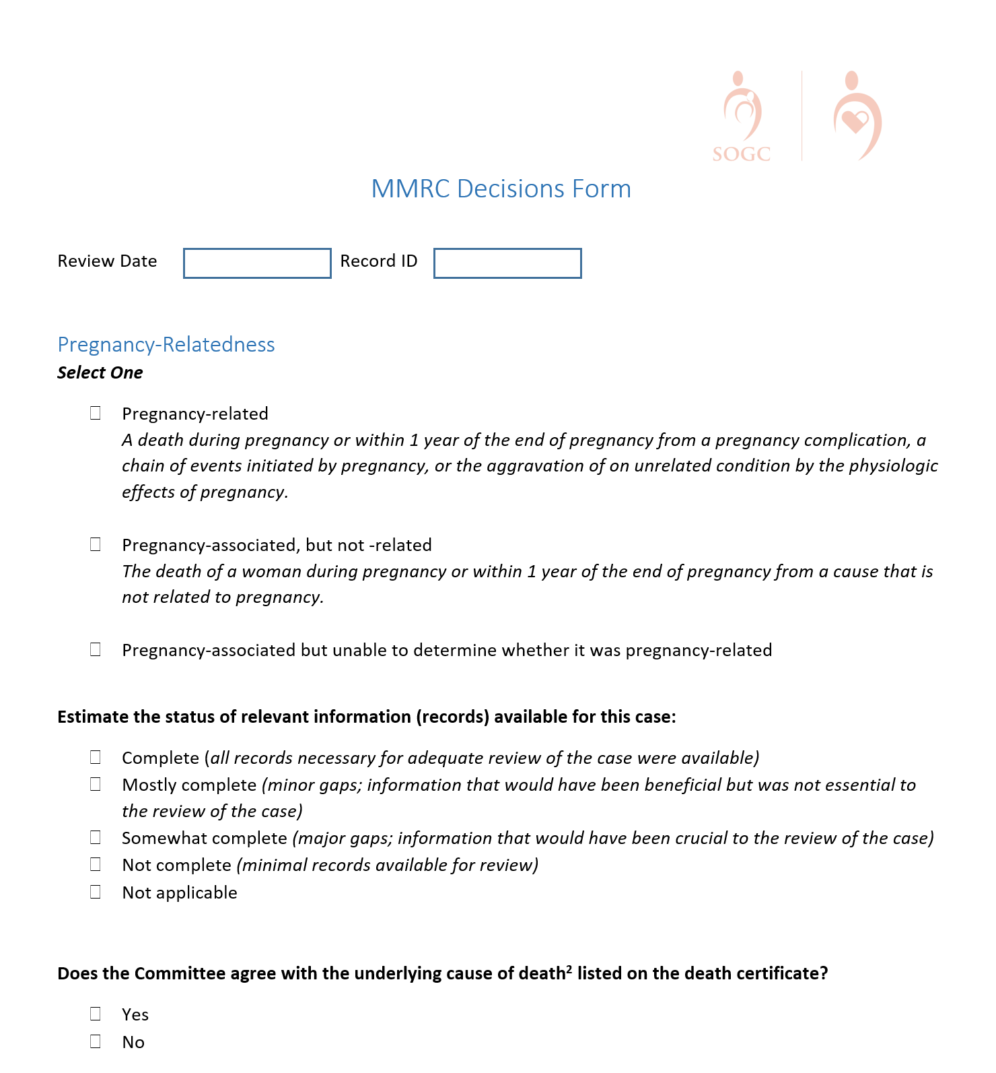
Standardized Committee Decisions Form
sogc.org
Notes:
Instructions to program:
Introduce the committee decisions form to the committee.
Recommend having printing versions for each participant in the orientation session to review while slides cover the major points of the form.
Here, it is important to go over the definitions again and emphasize the differences. The role of the committee will be to determine which definition best matches each case reviewed after full review of the abstracted information.
Explain this is where committee members can comment on the quality of records available for committee to review for the particular case in question. This data in the aggregate is a good quality measure for the program staff/abstractors.

Slide 36
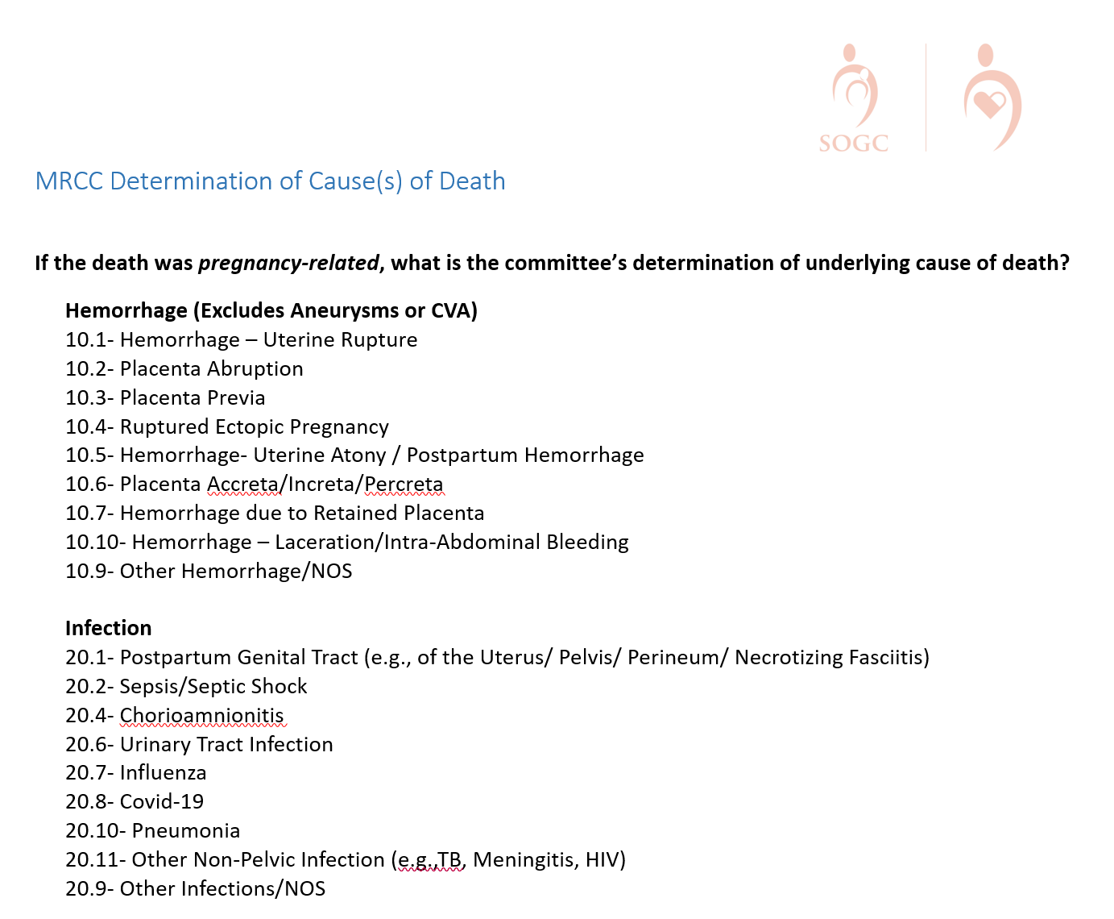
Determination of Cause(s) of Death
sogc.org
Notes:
Here, we highlight the differences in committee findings vs. death certificate findings. With the level of information available to review committees they often disagree with the underlying cause of death that is listed on the death certificate.
Here, the committee determines the immediate cause of death, contributing, the underlying cause of death, and documents any other significant conditions contributing to the death. These free text boxes are optional. They are often used by teams who want to document causes of pregnancy-associated, not related deaths.

Slide 37
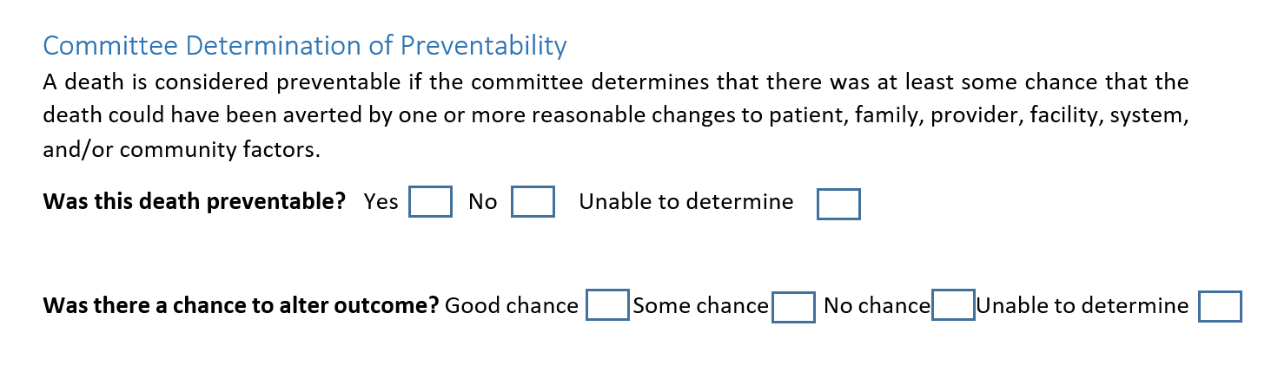
Was this a Preventable Death?
sogc.org
Notes:
Possible script for slide:
Possible script for slide:
Why determine preventability?
Preventability provides a framework of prioritization for recommendations.
Why do preventability estimates vary between MMRCs?
Preventability determinations are often a reflection of MMRC composition. Multidisciplinary MMRCs have a greater understanding of opportunities to prevent deaths.
What should our committee do if we get stuck on the preventability question?
It may be helpful to first discuss the factors that contributed to the death, and recommendations to address those contributing factors.
How can we avoid speculation in the case of inadequate or incomplete case information?
Inadequate information can make any case determination difficult. It’s important not to resort to speculation, stay on task, admit that you don’t know what you don’t know about the case and the facilitator may direct the committee to move on.
How can we help the media and the public broaden the focus on preventability, particularly beyond the provider/facility level?
Addressing medical factors alone will not get us to the reductions we want to achieve. In order to broaden this perspective committees must document factors and recommendations at all levels (Patient/Family, Provider, Facility, System and Community). Multidisciplinary review promotes understanding of patient-, community-, and system-level factors as well as development of actionable recommendation at all levels.
How can we craft recommendations that are useful to abstractors, analysts and for reporting to stakeholders and the public?
An actionable recommendation is mapped to a contributing factor and is structured as follows: [Who] should [do what], [when/where?] A diversity of voices at the table provide greater perspective on system-level factors that may influence factors such as late entry into prenatal care
Discuss how the form allows space for each contributing factor listed to be mapped to a recommendation for action.

Slide 38
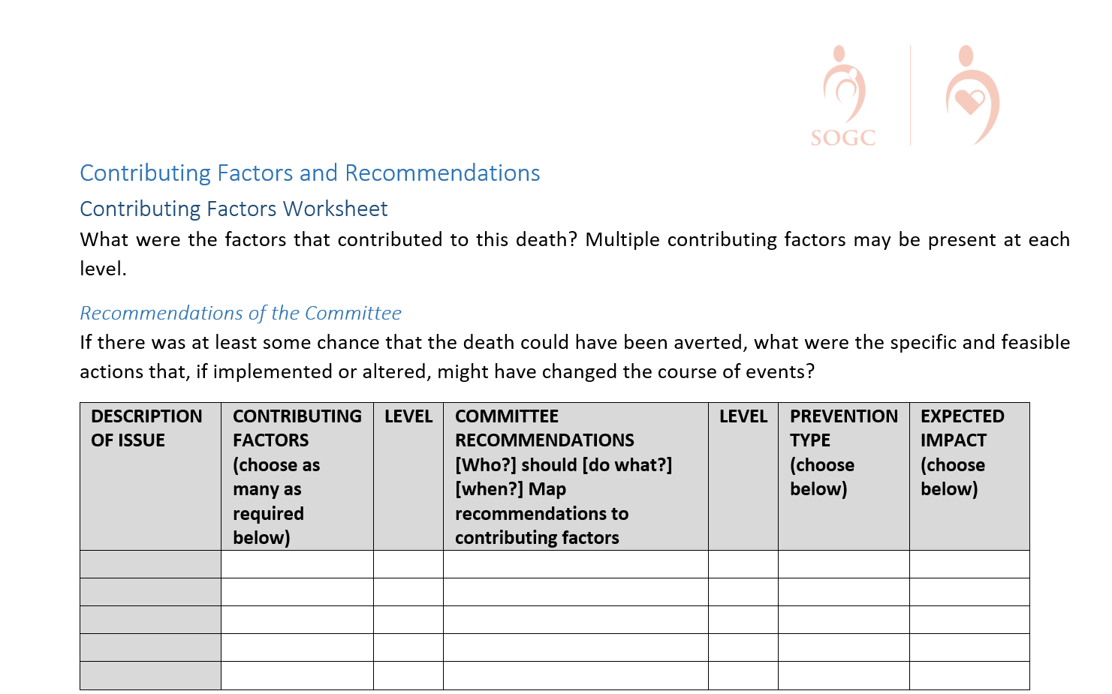
Recommendations
sogc.org

Slide 39
Was this a Preventable Death?
sogc.org
Notes:
Possible script for slide:
Possible script for slide:
Why determine preventability?
Preventability provides a framework of prioritization for recommendations.
Why do preventability estimates vary between MMRCs?
Preventability determinations are often a reflection of MMRC composition. Multidisciplinary MMRCs have a greater understanding of opportunities to prevent deaths.
What should our committee do if we get stuck on the preventability question?
It may be helpful to first discuss the factors that contributed to the death, and recommendations to address those contributing factors.
How can we avoid speculation in the case of inadequate or incomplete case information?
Inadequate information can make any case determination difficult. It’s important not to resort to speculation, stay on task, admit that you don’t know what you don’t know about the case and the facilitator may direct the committee to move on.
How can we help the media and the public broaden the focus on preventability, particularly beyond the provider/facility level?
Addressing medical factors alone will not get us to the reductions we want to achieve. In order to broaden this perspective committees must document factors and recommendations at all levels (Patient/Family, Provider, Facility, System and Community). Multidisciplinary review promotes understanding of patient-, community-, and system-level factors as well as development of actionable recommendation at all levels.
How can we craft recommendations that are useful to abstractors, analysts and for reporting to stakeholders and the public?
An actionable recommendation is mapped to a contributing factor and is structured as follows: [Who] should [do what], [when/where?] A diversity of voices at the table provide greater perspective on system-level factors that may influence factors such as late entry into prenatal care
Discuss how the form allows space for each contributing factor listed to be mapped to a recommendation for action.

Slide 40
Specific and Actionable Recommendations
______ should _________ ________.
(who?) (do what?) (when?)
WHO is the entity/agency who would have been/be responsible for the intervention?* | WHAT is the intervention and WHERE is the intervention point?* Patient/Family Provider Facility System Community | WHEN is the proposed intervention point? Among women of reproductive age (“preconception”) In pregnancy and in the postpartum period Labor & Delivery (L&D) Prior to L&D hospitalization discharge First 6 weeks postpartum 42-365 days postpartum
*Enter recommendation at the relevant level (Patient/Family, Provider, Facility, System, Community).
sogc.org

Slide 41
Conclusions
Canada urgently requires a Confidential Enquiry system into maternal deaths
MMRC is the foundation of a successful system
Canadian experts must work together with governments, provinces, and territories to determine key indicators, measurement, and meaningful data analysis strategies
These data and their comparisons will form the foundation of evidence to guide programs, policies, priorities, and interventions that will ultimately improve the health of mothers and babies
sogc.org

Slide 42





TOGETHER We Can Prevent Maternal Deaths
sogc.org

Slide 43
Questions??

